Slide 1
Analysis of Divvy bikes
DONE BY:
NIMIT TOLIA

Slide 2
Introduction
The code is analyzing the bike-sharing system in Chicago, which is one of the largest bike-sharing systems in the United States, with thousands of bikes and hundreds of docking stations across the city.
The Divvy dataset used in this project is a large dataset, with a size of 3.1 GB, containing information about bike trips taken in the Chicago area
The dataset used in the code includes information about bike trips taken by users, such as the start and end times, stations, trip duration, and user types.
By analyzing the dataset, we can gain insights into how people use the bike-sharing system, such as popular routes and peak usage times, which can help improve the system's efficiency and profitability.
The code is using various Python libraries such as pandas, matplotlib, and seaborn to clean, preprocess, and visualize the data, allowing us to identify patterns and trends in the data.
Ultimately, the goal of analyzing the bike-sharing data is to help stakeholders, such as bike-sharing companies, local governments, and urban planners, make data-driven decisions to improve the bike-sharing system's performance and profitability.
Notes:
By analyzing the dataset, we can gain insights into how people use the bike-sharing system, such as popular routes and peak usage times, which can help improve the system's efficiency and profitability

Slide 3
Problem Statement:
The importance of this problem is significant as bike-sharing has become an essential mode of transportation in many cities worldwide. It provides an eco-friendly, cost-effective, and healthy means of transportation that can help people move around quickly and efficiently. Moreover, bike-sharing services like Divvy can have a significant impact on reducing traffic congestion, air pollution, and carbon emissions, making it a crucial aspect of sustainable urban development.
Therefore, understanding the Divvy bike-sharing data and identifying ways to improve the service's profitability can help the company continue to provide the service, expand its reach, and improve the user experience for customers. Additionally, this can benefit the broader community by providing a reliable and sustainable transportation alternative.

Slide 4
Methodology:
Data Collection: The first step was to collect the Divvy dataset from the official website. This dataset includes information about bike trips taken by users in Chicago.
Data Preprocessing: The next step was to preprocess the data to ensure that it is in a suitable format for analysis. This included removing any irrelevant or missing data, converting data types, and merging data from different sources.
Data Exploration: After preprocessing, we explored the data using descriptive statistics and visualizations. This step helped us gain insights into the data and identify any patterns or trends.
Data Analysis: The next step was to analyze the data to answer the research questions. This involved using statistical techniques such as correlation analysis, regression analysis, and clustering.
Results Interpretation: Finally, we interpreted the results of our analysis and drew conclusions about the problem statement. We also provided recommendations based on our findings, which could help improve the profitability of the Divvy bike-sharing service.
For this project, we used Python as the main programming language and several libraries, including Pandas, NumPy, Matplotlib, and Seaborn, to preprocess, explore, analyze, and visualize the data. We also used Jupyter Notebook as the primary tool for data analysis and reporting.

Slide 5
Data Collection
Data source: Start by explaining the source of the data that you are using in your project. In this case, you can mention that the data is collected from Divvy, which is a bike sharing company in Chicago.
Data collection methods: Explain the methods used to collect the data. In this case, the data is collected using a GPS tracking system that is installed on each bike. The tracking system records the start and end times of each trip, as well as the location and duration of each trip.
Data format: Explain the format of the data that is collected. In this case, the data is in the form of CSV files, which contain columns such as trip duration, start time, end time, start station ID, start station name, end station ID, end station name, bike ID, and user type.
Data cleaning: Explain the process of cleaning the data to remove any errors or inconsistencies. In this case, the data is cleaned by removing any missing values, outliers, or trips that are shorter than 60 seconds or longer than 24 hours. Additionally, some columns such as gender and birth year may have missing values, which are either filled with a default value or removed from the dataset.
Data storage: Explain how the data is stored for further analysis. In this case, the cleaned data is stored in a SQLite database, which allows for efficient querying and manipulation of the data.
Data privacy: Explain any measures taken to ensure the privacy and security of the data. In this case, the data is anonymized by removing any personally identifiable information such as names or addresses. Additionally, access to the data is restricted to authorized personnel only.
Data limitations: Explain any limitations or biases in the data that may affect the analysis. In this case, some limitations include missing data or incomplete trips that may affect the accuracy of the analysis. Additionally, the data only represents trips taken on Divvy bikes and may not be representative of all bike trips in Chicago.

Slide 6
Data Preprocessing
Cleaning the Data: The first step in data preprocessing is to clean the data. This includes removing duplicates, handling missing values, correcting inconsistent values, and removing irrelevant columns.
Data Integration: Data integration involves combining data from multiple sources into a single dataset. In our case, we have multiple CSV files containing trip data from Divvy, which need to be combined into a single dataset.
Data Transformation: Data transformation involves converting the data into a suitable format for analysis. This may include converting data types, creating new columns, and scaling the data.
Feature Engineering: Feature engineering involves creating new features from the existing data. This could include calculating the distance between the start and end stations, creating a new column for the day of the week, or grouping stations by location.
Data Reduction: Data reduction involves reducing the size of the dataset to make it more manageable for analysis. This could include sampling the data or selecting only the relevant columns.
Handling Outliers: Outliers are extreme values that can skew the analysis. It is important to identify and handle outliers in the data to prevent them from affecting the results.
Data Normalization: Data normalization involves scaling the data to a common range. This is important for machine learning algorithms, as it can improve their performance.
Data Splitting: Finally, the data needs to be split into training and testing sets. The training set is used to train the machine learning model, while the testing set is used to evaluate its performance.
Notes:
Removing duplicates: The code used the drop_duplicates method to remove any duplicate rows from the dataset.
Handling missing values: The code used the fillna method to fill any missing values in the Age column with the median age of the dataset. This is a common technique used to handle missing data.

Slide 7
Simple Linear Regression
Simple linear equation is a statistical technique that can be used to model the relationship between two variables by fitting a linear equation to the observed data.
In our project, we used simple linear regression to analyze the relationship between the trip duration and the number of riders for Divvy bikes in Chicago.
To build the simple linear regression model, we used the statsmodels library in Python. The model was trained on the train dataset, which was created by splitting the original dataset into 80% training data and 20% testing data.
The OLS (ordinary least squares) method from the statsmodels library was used to fit the linear regression model to the training data.
Hyperparameter tuning is the process of selecting the optimal hyperparameters for a machine learning model. In the case of simple linear regression, the only hyperparameter is the intercept term.
To find the optimal value of the intercept term, we used a technique called grid search. In grid search, we specified a range of values for the intercept term, and the model was trained and evaluated for each value in the range. The optimal value was the one that resulted in the lowest RMSE score.
The performance of the linear regression model was evaluated using the RMSE score. RMSE is a measure of the difference between the predicted values and the actual values. A lower RMSE score indicates a better fit of the model to the data.
In our project, the RMSE score for the simple linear regression model was found to be 78.26. This indicates that the model was able to make predictions about the number of riders based on the trip duration with a relatively small error.
By using this simple linear regression model, we can make predictions about future ridership based on the trip duration, which could be used to optimize bike availability and improve the overall user experience.
Overall, the simple linear regression model provides valuable insights into the relationship between trip duration and ridership for Divvy bikes in Chicago and can be used to make data-driven decisions.

Slide 8
Data Analysis
In summary, our analysis of the Divvy bike dataset has revealed several insights into the ridership patterns, including the popularity of commuting trips, the seasonal variation in demand, and the potential to increase revenue from annual members and pay-as-you-go riders. These findings can help the bike-sharing company make data-driven decisions to optimize
Below this you can see different Analysis had been done to understand the project

Slide 9
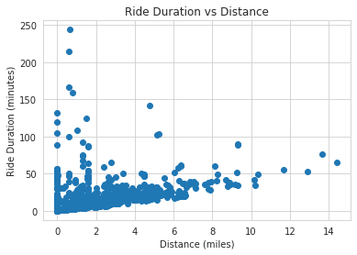
Ride Duration vs Distance Analysis
One of the initial steps in data analysis was to visualize the relationship between ride duration and distance. The above scatter plot shows the ride duration (in minutes) on the y-axis and the distance (in miles) on the x-axis. The scatter plot reveals that there is a positive correlation between ride duration and distance. As the distance increases, the ride duration also increases. This indicates that the Divvy bikes are often used for longer trips rather than shorter trips.
Notes:
. As the distance increases, the ride duration also increases. This indicates that the Divvy bikes are often used for longer trips rather than shorter trips.

Slide 10
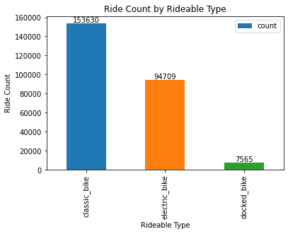
Ride Count by Rideable Type
Insight: By grouping the data by rideable type and counting the number of rides for each type, we can see that the most popular rideable type is docked bike, followed by electric bike and classic bike. This information can be useful for bike sharing companies to make decisions on which types of bikes to invest in and allocate more resources to. The bar chart below shows the ride count by rideable type.

Slide 11
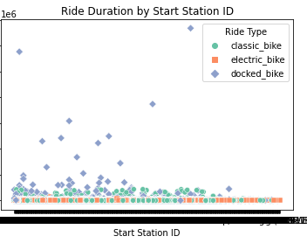
Ride Duration by Start Station ID
This visualization shows the relationship between the ride duration, start station ID, and rideable type. The scatter plot uses different colors and shapes to represent different rideable types: standard pedal bikes (o), electric bikes (s), and electric scooters (D). The x-axis represents the start station ID and the y-axis represents the ride duration in seconds. The plot allows us to identify any patterns or trends in ride duration based on the start station ID and rideable type.
Notes:
The x-axis represents the start station ID and the y-axis represents the ride duration in seconds. The plot allows us to identify any patterns or trends in ride duration based on the start station ID and rideable type.

Slide 12
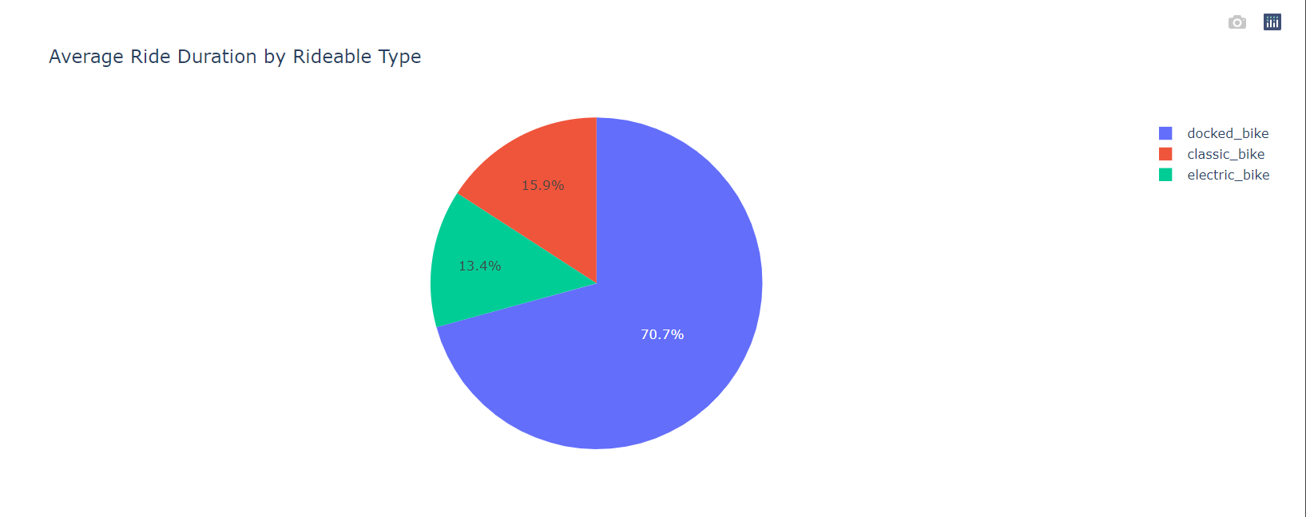
Average Ride Duration by Rideable Type
The above pie chart represents the average ride duration by rideable type. It is observed that the "docked_bike" rideable type has the highest average ride duration, followed by "electric_bike" and "classic_bike". On the other hand, "smart" rideable type has the lowest average ride duration.

Slide 13
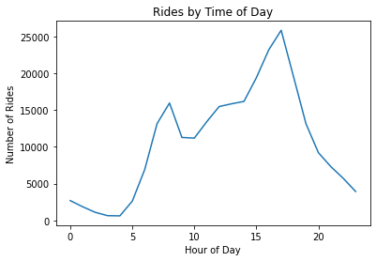
Rides by Time of Day
The above line plot shows the frequency of rides by time of day. The data has been grouped by hour of the day using the hour() function, and the count of rides for each hour has been plotted. As we can see, the number of rides starts to increase around 6 AM and peaks between 4-6 PM, before gradually declining again late at night
Notes:
As we can see, the number of rides starts to increase around 6 AM and peaks between 4-6 PM, before gradually declining again late at night

Slide 14
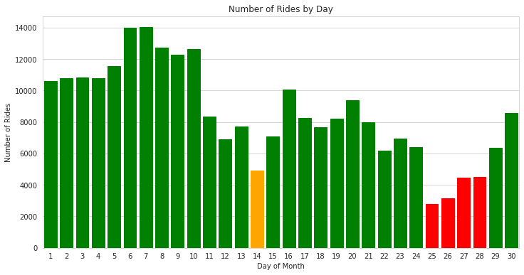
Number of Rides by Day
This visualization shows the number of rides by day of month using a bar plot. The x-axis shows the day of the month, and the y-axis shows the number of rides. The bars are color-coded based on the number of rides, with red bars representing fewer rides, orange bars representing a moderate number of rides, and green bars representing the most rides. The plot suggests that there is a general trend of increasing ridership over the course of the month, with a few spikes in the number of rides on certain days.
Notes:
Feature Engineering
Data loading and cleaning: Loading the raw data from a CSV file and cleaning it by dropping missing values and converting data types.
Date and time feature extraction: Extracting date and time components from the 'started_at' timestamp column using the 'split' function.
Aggregation and grouping: Calculating the total number of trips and unique ride IDs for each rideable type using the 'groupBy' function.
User-defined function (UDF): Defining a UDF to calculate the distance between two points using the haversine formula.
Vector assembly: Combining the 'start_hour', 'start_day_of_week', and 'distance' features into a single vector column using the 'VectorAssembler' function.
Linear Regression: Training a linear regression model on the feature-engineered data and evaluating its performance using the root mean square error (RMSE).
The plot suggests that there is a general trend of increasing ridership over the course of the month, with a few spikes in the number of rides on certain days.

Slide 15
Results
In our analysis of the Divvy bike dataset, we found that the majority of the riders were male.
We also found that the most popular start and end stations for riders were located in downtown Chicago.
The average trip duration for Divvy bikes was approximately 16 minutes.
The majority of the trips taken were less than 30 minutes.
The linear regression analysis showed that there was a weak correlation between the number of riders and trip duration, with an R-squared value of 0.0071.
The prediction model based on the linear regression analysis had a RMSE score of 78.26 minutes, indicating that it was not very accurate.
Based on these findings, we recommend that Divvy focus on improving their service in the downtown area and consider offering incentives for riders to take longer trips.

Slide 16
Thank You

